Slide 1
Overview of Operating System
Module 1

Slide 2
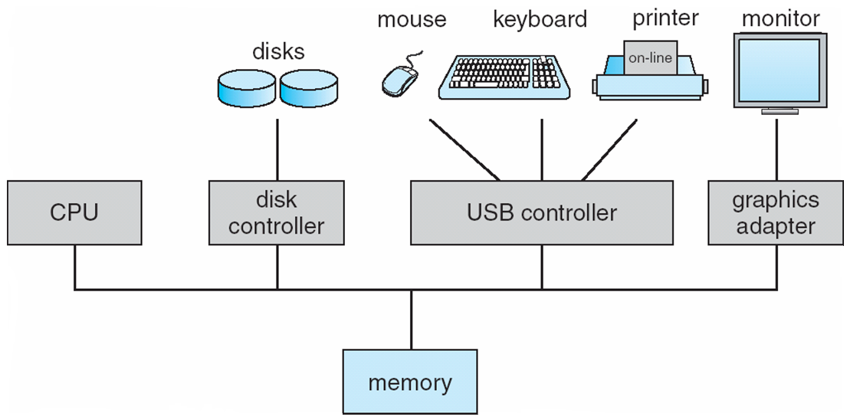

Computer System Organization

Slide 3
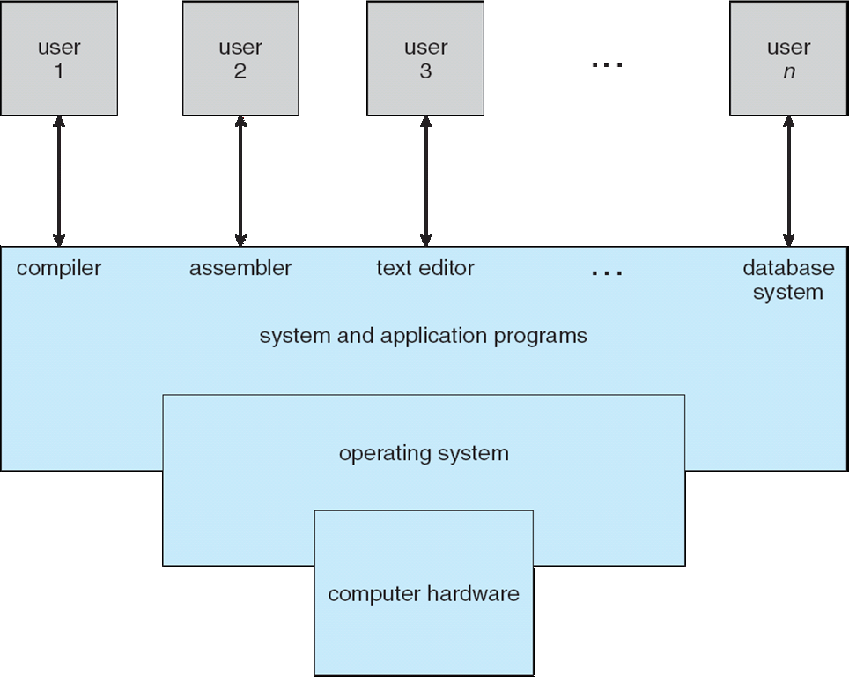

4 layers of Computer System

Slide 4
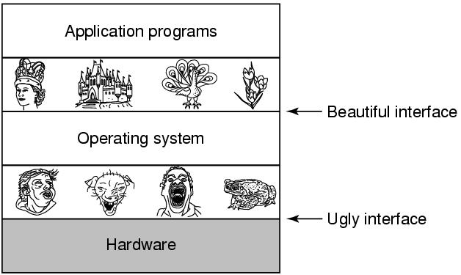

Why need so many layers ?

Slide 5

What is an Operating System?
A program that acts as an intermediary between a user of a computer and the computer hardware
Operating system Goals/ Objectives:
Execute user programs and make solving user problems easier
Make the computer system convenient to use
Use the computer hardware in an efficient manner

Slide 6

Functions of Operating System
OS is a Resource Manager
Allocates/ Deallocates all resources
Process Management for Processor(s)
Memory Management
I/O Management
File Management
Decides between conflicting requests for efficient and fair resource use
OS is a Control Program
Controls execution of programs to prevent errors and improper use of the computer

Slide 7

Definition of OS – No exact Definition
“The one program running at all times on the computer” is the kernel.
Everything else is either
a system program (ships with the operating system) , or
an application program.
Can single CPU execute multiple programs/ processes simultaneously?
No, processes execute in time-shared mode on single CPU (Multi-Processing)
If Kernel program is always running, then how other programs run?
OS kernel instantiates a program as a process, allots it a process id to monitor it and schedules it for execution.

Slide 8

I/O Operations using Interrupt
I/O devices and the CPU can execute concurrently
Each device controller is in charge of a particular device type
Each device controller has a local buffer
CPU moves data from/to main memory to/from local buffers
I/O is from the device to local buffer of controller
Device controller informs CPU that it has finished its operation by causing an interrupt (System Call)

Slide 9

Common functions of interrupt
Interrupt transfers control to the interrupt service routine generally, through the interrupt vector, which contains the addresses of all the service routines
Interrupt architecture must save the address of the interrupted instruction
A trap or exception is a software-generated interrupt caused either by an error or a user request
An operating system is interrupt driven. Kernel of OS is a collection of Interrupt Service Routines (ISRs).

Slide 10

Interrupt Handling
The operating system preserves the state of the CPU by storing registers and the program counter
Determines which type of interrupt has occurred:
polling
vectored interrupt system
Separate segments of code determine what action should be taken for each type of interrupt

Slide 11
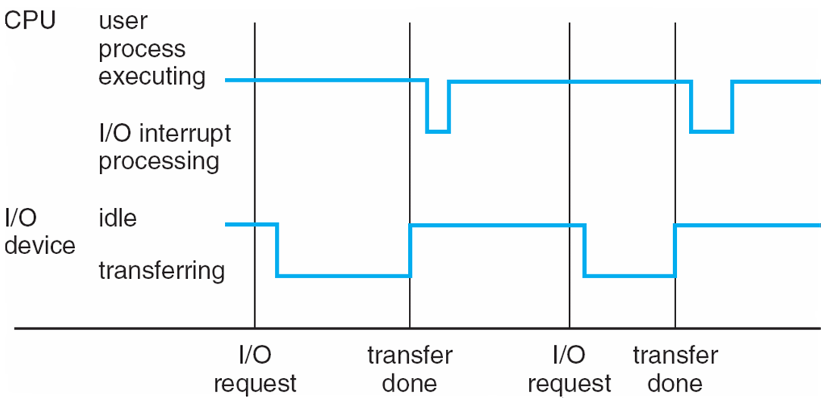

Interrupt Timeline

Slide 12
Interrupt types
Interrupt driven (hardware and software)
Hardware interrupt by one of the devices
Software interrupt (exception or trap):
Software error (e.g., division by zero)
Request for operating system service
Other process problems include infinite loop, processes modifying each other or the operating system

Slide 13

I/O Structure
After I/O starts, control returns to user program only upon I/O completion
Wait instruction idles the CPU until the next interrupt
Wait loop (contention for memory access)
At most one I/O request is outstanding at a time, no simultaneous I/O processing
After I/O starts, control returns to user program without waiting for I/O completion
System call – request to the OS to allow user to wait for I/O completion
Device-status table contains entry for each I/O device indicating its type, address, and state
OS indexes into I/O device table to determine device status and to modify table entry to include interrupt

Slide 14

Storage Structure
Main memory – only large storage media that the CPU can access directly
Random access
Typically volatile
Secondary storage – extension of main memory that provides large nonvolatile storage capacity
Hard disks – rigid metal or glass platters covered with magnetic recording material
Disk surface is logically divided into tracks, which are subdivided into sectors
The disk controller determines the logical interaction between the device and the computer
Solid-state disks – faster than hard disks, nonvolatile
Various technologies
Becoming more popular

Slide 15
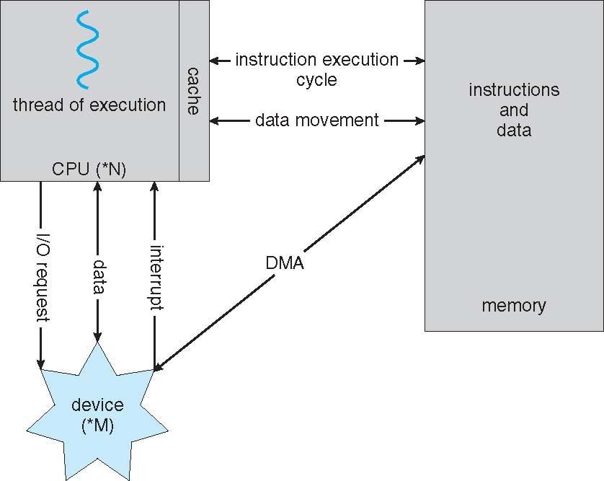

How modern computer system works

Slide 16

OS operations
Dual-mode operation allows OS to protect itself and other system components
User mode and kernel mode
Mode bit provided by hardware
Provides ability to distinguish when system is running user code or kernel code
Some instructions designated as privileged, only executable in kernel mode
System call changes mode to kernel, return from call resets it to user
Increasingly CPUs support multi-mode operations
i.e. virtual machine manager (VMM) mode for guest VMs

Slide 17
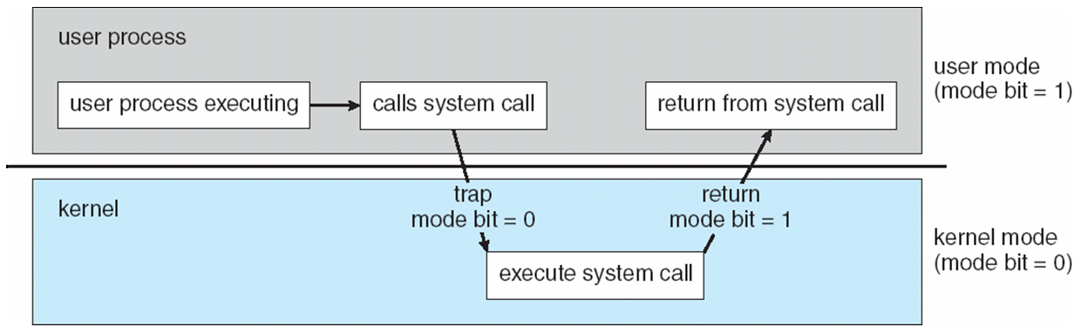

Transition from User to Kernel mode

Slide 18

Avoiding infinite loop or process hogging
Timer to prevent infinite loop / process hogging resources
Timer is set to interrupt the computer after some time period
Keep a counter that is decremented by the physical clock.
Operating system set the counter (privileged instruction)
When counter zero generate an interrupt
Set up before scheduling process to regain control or terminate program that exceeds allotted time.

Slide 19
Evolution of Computer System

Slide 20

From No OS to Time Sharing system….
-> is logical extension in which CPU switches jobs so frequently that users can interact with each job while it is running, creating interactive computing
-> organizes jobs (code and data) in memory, so that when one job waits (ex. for I/O), job scheduler can switch CPU for another job.
Time Sharing Systems
-> user no longer has direct access to processor. Resident monitor reads in job and controls sequence of events.
Multiprogrammed Batch Systems
-> a considerable amount of time was spent just on setting up the program to run
Simple Batch Systems
Serial Processing

Slide 21
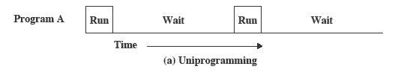

Serial Processing (Uni-Programming)
The processor spends a certain amount of time executing, until it reaches an I/O instruction; it must then wait until that I/O instruction concludes before proceeding
There must be enough memory to hold the OS (resident monitor) and one user program

Slide 22
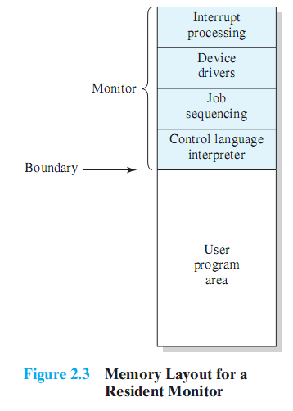

Simple Batch Systems
Early computers were very expensive
Needed important to maximize processor utilization
In Simple Batch System
User no longer has direct access to processor
A batch of jobs is queued up, and jobs are executed as rapidly as possible, with no intervening idle time
Resident monitor controls the sequence of events and performs scheduling.
Program branches back to the monitor when finished
Overhead in Simple Batch System
Processor time alternates between execution of user programs and execution of the monitor
Some main memory is now given over to the monitor

Slide 23
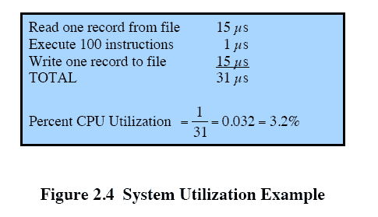

Problem with Simple Batch Systems
Processor is often idle
even with automatic job sequencing
I/O devices are slow compared to processor

Slide 24
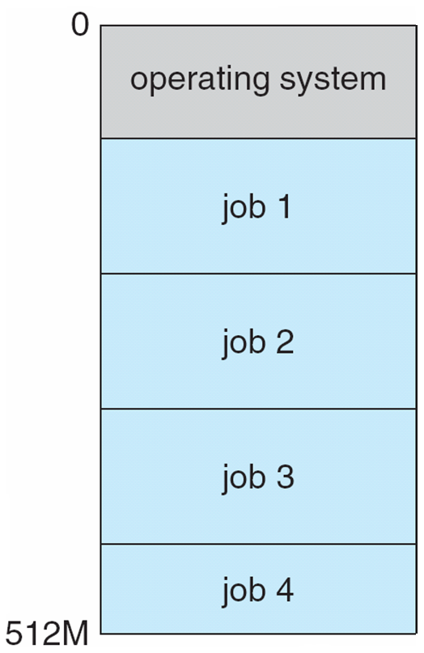

Memory layout for Multi-Programmed Batch system

Slide 25
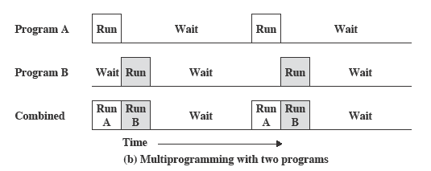

Multi-Programming & Multi-tasking : Similarity
When one job needs to wait for I/O, the processor can switch to the other job, which is likely not waiting for I/O.
Memory is expanded to hold three, four, or more programs and switch among all of them.

Slide 26

Multi-Programming Batch & Time-Shared Multi-tasking : Difference
Multiprogramming (Batch) needed for efficiency (Maximize processor use)
Single user cannot keep CPU and I/O devices busy at all times
Multiprogramming organizes jobs (code and data) so CPU always has one to execute
A subset of total jobs in system is kept in memory
One job selected and run via job scheduling
When it has to wait (for I/O for example), OS switches to another job
Timesharing (multitasking) is logical extension in which CPU switches jobs so frequently that users can interact with each job while it is running, creating interactive computing by minimizing Response Time. (Response time should be < 1 second)
Each user has at least one program executing in memory process
If several jobs ready to run at the same time  CPU scheduling
If processes don’t fit in memory, swapping moves them in and out to run
Virtual memory allows execution of processes not completely in memory

Slide 27
OS Structure / Architecture

Slide 28
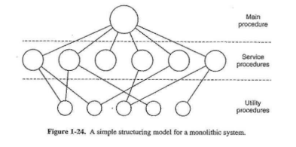

Monolithic Systems
A main program that invokes the requested service procedure.
A set of service procedures that carry out the system calls.
A set of utility procedures that help the service procedures.

Slide 29
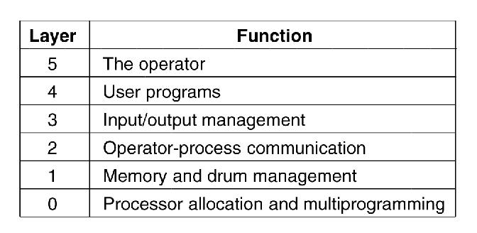

Layered Systems

Slide 30

Difference between Monolithic and Layered
Monolithic | Layered
Complete OS functions inside the kernel space itself. | OS functions are divided into multiple layers.
It consists of a total of three layers. | It consists of multiple layers which cannot be allotted a fixed number.
Components interact directly with one another. | Components do not interact directly with one another.
Lesser modularity. | More modularity.
Debugging and modification are less accessible. | Debugging and modification are more accessible.

Slide 31
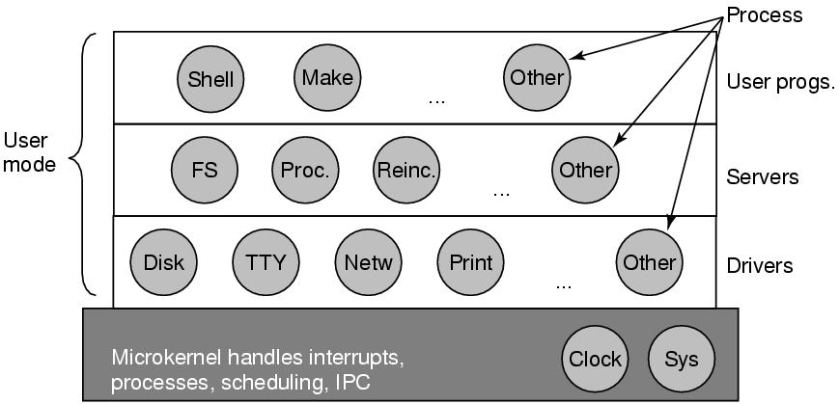

Microkernels

Slide 32

Difference between Monolithic and Microkernel
S. No. | Parameters | Microkernel | Monolithic kernel
1. | Address Space | In microkernel, user services and kernel services are kept in separate address space. | In monolithic kernel, both user services and kernel services are kept in the same address space.
2. | Design and Implementation | OS is complex to design. | OS is easy to design and implement.
3. | Size | Microkernel are smaller in size. | Monolithic kernel is larger than microkernel.
4. | Functionality | Easier to add new functionalities. | Difficult to add new functionalities.
5. | Coding | To design a microkernel, more code is required. | Less code when compared to microkernel
6. | Failure | Failure of one component does not effect the working of micro kernel. | Failure of one component in a monolithic kernel leads to the failure of the entire system.
7. | Processing Speed | Execution speed is low. | Execution speed is high.

Slide 33

Difference between Monolithic and Microkernel
S. No. | Parameters | Microkernel | Monolithic kernel
8. | Extend | It is easy to extend Microkernel. | It is not easy to extend monolithic kernel.
9. | Communication | To implement IPC messaging queues are used by the communication microkernels. | Signals and Sockets are utilized to implement IPC in monolithic kernels.
10. | Debugging | Debugging is simple. | Debugging is difficult.
11. | Maintain | It is simple to maintain. | Extra time and resources are needed for maintenance.
12. | Message passing and Context switching | Message forwarding and context switching are required by the microkernel. | Message passing and context switching are not required while the kernel is working.
13. | Services | The kernel only offers IPC and low-level device management services. | The Kernel contains all of the operating system’s services.
14. | Example | Example : Mac OS X. | Example : Microsoft Windows 95.

Slide 34
System Calls

Slide 35

System Calls
Programming interface to the services provided by the OS
Typically written in a high-level language (C or C++)
Mostly accessed by programs via a high-level Application Programming Interface (API) rather than direct system call use
Three most common APIs are Win32 API for Windows, POSIX API for POSIX-based systems (including virtually all versions of UNIX, Linux, and Mac OS X), and Java API for the Java virtual machine (JVM)
Note that the system-call names used throughout this text are generic

Slide 36
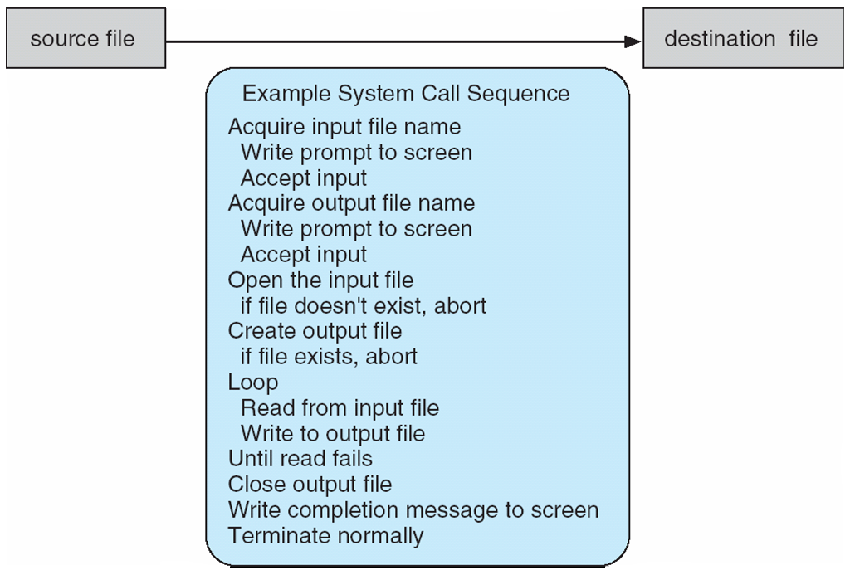

Example of System Call for copy file (cp of Linux)

Slide 37

System Call Implementation / Invoking System Call
Typically, a number associated with each system call
System-call interface maintains a table indexed according to these numbers
The system call interface invokes the intended system call in OS kernel and returns status of the system call and any return values
The caller need know nothing about how the system call is implemented
Just needs to obey API and understand what OS will do as a result call
Most details of OS interface hidden from programmer by API
Managed by run-time support library (set of functions built into libraries included with compiler)

Slide 38
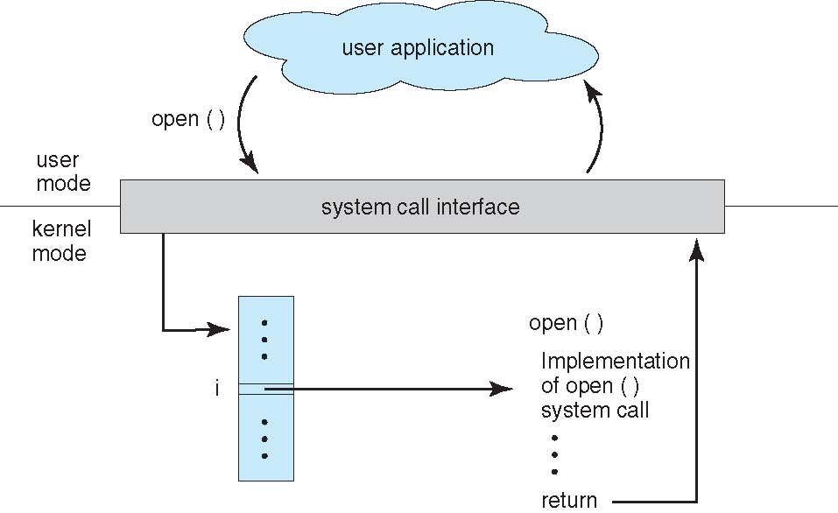

System Call Implementation

Slide 39

Types of System Calls
Process control
create process, terminate process
end, abort
load, execute
get process attributes, set process attributes
wait for time
wait event, signal event
allocate and free memory
Dump memory if error
Debugger for determining bugs, single step execution
Locks for managing access to shared data between processes

Slide 40

Types of System Calls (Cont.)
File management
create file, delete file
open, close file
read, write, reposition
get and set file attributes
Device management
request device, release device
read, write, reposition
get device attributes, set device attributes
logically attach or detach devices
Information maintenance
get time or date, set time or date
get system data, set system data
get and set process, file, or device attributes

Slide 41

Types of System Calls (Cont.)
Communications
create, delete communication connection
send, receive messages if message passing model to host name or process name
From client to server
Shared-memory model create and gain access to memory regions
transfer status information
attach and detach remote devices
Protection
Control access to resources
Get and set permissions
Allow and deny user access

Slide 42
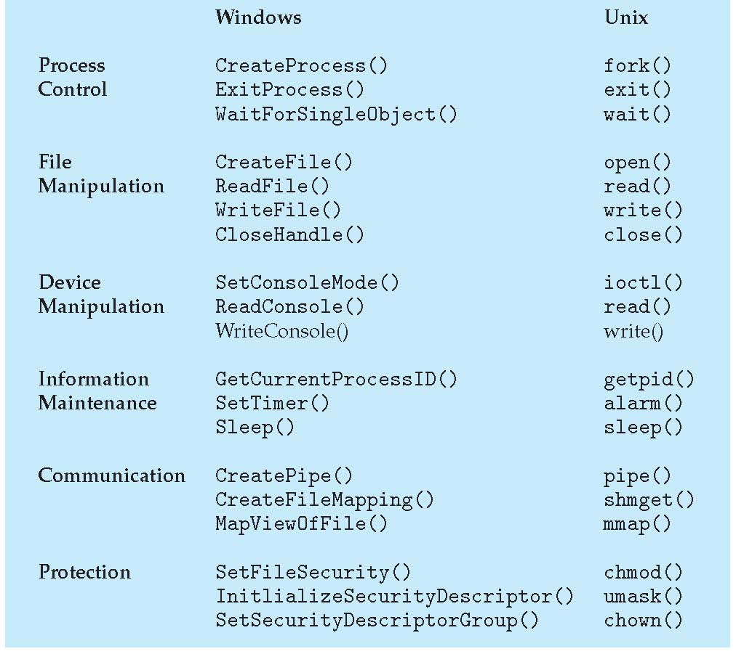

Examples of Windows and Unix System Calls

Slide 43

Summary
OS acts as an intermediate layer between hardware and other programs thereby providing a layer of abstraction. It acts as a resource allocator and control program.
OS is interrupt driven. A system call service (service from kernel) is invoked through interrupts.
Interrupts can be software interrupts such as, running program requires a file to be opened.
Interrupts can be hardware interrupts such as, I/O device ready for data communication.
Special Interrupts occur due errors/ exceptions such as a program running in infinite loop.
Evolution from Serial Processing to Time-Shared Operating Systems
Architecture: Monolithic, Layered and Microkernel
System Calls and their Implementation

Slide 44

Thank You…

